Slide 1
Chapter Five
SERVER- SIDE SCRIPTING-PHP

Slide 2

Contents
Introduction to server-side programming
  Server-side Languages
PHP Basics
  What is PHP?
  Common uses of PHP
  PHP Pros and Cons
  Elements of PHP
  Installing
Patterns for processing HTML forms
  Understanding $_GET, $_POST, $_SESSION and other PHP super-arrays
Dynamically generating HTML
Manipulating MySQL Databases with PHP

Slide 3

Introduction to server-side Scripting
Is a technique used in web development which involves employing scripts on a web server which produce a response customized for each user's (client's) request to the website.
Is the general name for the kinds of programs which are run on the Server
Uses
Process user input.
Display pages.
Structure web applications.
Interact with permanent storage (SQL, files).

Slide 4
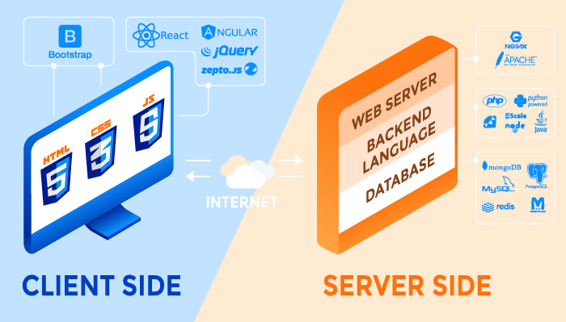
Server-side Languages
PHP
ASP
Ruby
Python
Java …

Slide 5
What is PHP?
PHP == ‘PHP: Hypertext Preprocessor’ –recursive acronym
Open-source, server-side scripting language
Used to generate dynamic web-pages
PHP is an interpreted language, i.e. there is no need for compilation.
PHP is simple and easy to learn language.
PHP scripts reside between reserved PHP tags
  This allows the programmer to embed PHP scripts within HTML

Slide 6
Common uses of PHP
  PHP performs system functions, i.e. from files on a system it can create, open, read, write, and close them.
  PHP can handle forms, i.e. gather data from files, save data to a file, through email you can send data, return data to the user.
  You add, delete, and modify elements within your database through PHP.
  Access cookies variables and set cookies.
  Using PHP, you can restrict users to access some pages of your website.
  It can encrypt data.

Slide 7
PHP Advantages
it’s open source and free from cost.
it is platform independent
Application can easily be loaded which are based on PHP and connected to database.
  It’s mainly due to its faster rate of loading over slow internet speed than another programming language.
It has less learning curve - easy
Supports OOP
Built-in database support minimizes dev time- on CMS
Very popular and huge community for support
Flexible – can be combined with different languages
Notes:
https://www.geeksforgeeks.org/advantages-and-disadvantages-of-php/

Slide 8
PHP Disadvantages
It is not that secure due to its open-source, because the ASCII text file are often easily available.
It is not suitable for giant content-based web applications.
Using more features of PHP framework and tools cause poor performance of online applications.
PHP don’t allow change or modification in core behavior of online applications.
The PHP frameworks aren’t equivalent in behavior so does their performance and features.
While PHP may be a powerful tool supported by an outsized community and plentiful reference documentation, there are easier programming languages for web apps.
Notes:
https://www.geeksforgeeks.org/advantages-and-disadvantages-of-php/

Slide 9
Installing PHP
To install PHP, AMP (Apache, MySQL, PHP) software stack is suggested. It is available for all operating systems.
  WAMP for Windows
  LAMP for Linux
  MAMP for Mac
  SAMP for Solaris
  FAMP for FreeBSD
  XAMPP (Cross, Apache, MySQL, PHP, Perl) for Cross Platform: It includes some other components too such as FileZilla, OpenSSL, Webalizer, Mercury Mail etc.

Slide 10
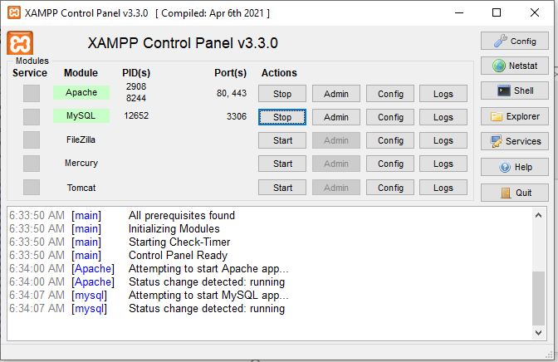
Web servers- xampp control panel

Slide 11
Elements of PHP : Tags and Syntax
Each PHP script must be enclosed in the reserved PHP tag
Php script is embedded in html code or included as external file
  Use <?php as a start tag for php and ?> as a closing tag
  Can be embedded anywhere in the html code, head ,body or inline with html tags depending on the need of the programmer
  All PHP statements end with a semi-colon
  Use include(‘phpfile.php’) or require(‘phpfile.php’) functions to include external php code to html file.
  Php script can also be attached to forms action attribute.
<?php
//php code goes here
?>
Notes:
https://users.astro.ufl.edu/~warner/prog/php.html

Slide 12
Elements of PHP: Tags and Syntax
<?php
if($condition){
?>
<b> This is True </b>
<?php
} else {
?>
<b> This is False </b>
<?php
}
?>
Comments in PHP
// C++ and Java-style comment
# Shell-style comments
/* C-style comments
These can span multiple lines */
Notes:
https://users.astro.ufl.edu/~warner/prog/php.html

Slide 13
Elements of PHP : Variables and Datatypes
Variables in php are start with a dollar($) symbol followed by valid identifier name
  Variable names are case sensitive
  Variables should be initialized before use – no declaration or type
PHP supports the following data types:
  boolean
  integer
  float
  string
  array
  object
  resource
  NULL
<?php
$age = 25; // Numerical variable
$name = "Sami"; // String variable
echo $name .“ is ".$age." years old";
$age = ($age * 7); // Multiplies age by 7
$name = ($name * 7); // Invalid expression
?>
Notes:
https://users.astro.ufl.edu/~warner/prog/php.html

Slide 14
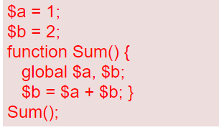
Elements of PHP: Variables scope
Local Variables: Any variable used inside a user-defined function, however, has its scope limited to the local function.
Global variables are not available inside local functions unless declared with the global keyword:
Notes:
https://users.astro.ufl.edu/~warner/prog/php.html

Slide 15
Elements of PHP : Statements and Expressions
Some basic PHP statements include:
  echo: Output one or more strings.
  print: Also output one or more strings.
  The assignment statement: Assigns a value to a variable.
  include: Include and evaluate the specified file.
  require: Same as include except it produces a fatal error on failure instead of a warning.
PHP expressions can include:
$a = $b = 5; //The assignment statement
$b = $a++; //Post-increment a
$b = ++$a; //Pre-increment a
$x = $bool ? $a : $b; //Ternery conditional
Notes:
https://users.astro.ufl.edu/~warner/prog/php.html

Slide 16
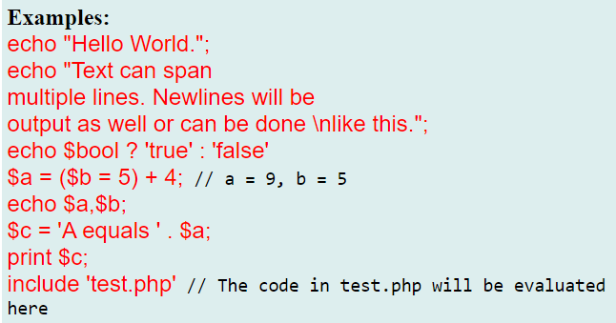
Elements of PHP: Statements and Expressions
Notes:
https://users.astro.ufl.edu/~warner/prog/php.html

Slide 17
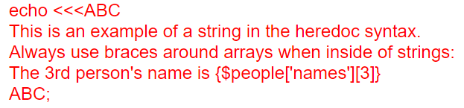
Elements of PHP: Strings
Strings can be specified in 3 ways: single quotes, double quotes, or heredoc.
  if a string is enclosed in double quotes, escapes such as \n, \r, \t, \\, and \" may be used and variables are interpreted
  Heredoc syntax: Starts with <<< followed by an identifier. Ends with the identifier repeated at the start of a line.
Notes:
https://users.astro.ufl.edu/~warner/prog/php.html

Slide 18
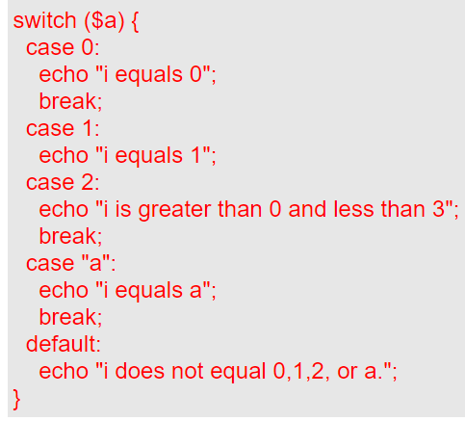
Elements of PHP: Conditionals
  if: if (expr) statement;
  if-else: if (expr) statement1; else statement2;
  if-elseif: if (expr) statement1;
  elseif (expr) statement2;
  else statement3;
  switch: switch($var) {
  case 0: statements;
  break;
  case "n": statements;
  break;
  default: statements;
  }
Notes:
https://users.astro.ufl.edu/~warner/prog/php.html

Slide 19
Elements of PHP: Loops
  for:
  while:
  do...while:
  foreach:
    Loops through a block of code for each element in an array;
    On each iteration, the value of the current element is assigned to $value and the internal array pointer is advanced by one.
  break
  continue
  for (expr1; expr2; expr3) statements;
        while (expr) statements;
Same as C++ syntax
  do { statements; } while (expr);
foreach ($array as $value) {
code to be executed;
}
Notes:
https://users.astro.ufl.edu/~warner/prog/php.html

Slide 20
Elements of PHP
$value=array(“html", “css", “js", “php"", “mysql");
for ($j = 0; $j < 5; $j++) {
echo "Value at $j is {$value[$j]} <br>";
}
$i = 10;
do {
echo "This will execute at least once.";
} while ($i < 10);
$colors = array("red", "green", "blue", "yellow");
foreach ($colors as $value) {
echo "$value <br>";
}
for ($x = 0; $x < 10; $x++) {
if ($x == 4) {
break;
}
echo "The number is: $x <br>";
}
Loops - example
for ($j = 0; $j < 10; $j++) {
while($k < $j) {
echo "j = $j, k = $k";
if ($j == 1) break;
if ($j % 2 == 1) continue 2;
$k++;
} echo "j is even or j equals 1.<br>";
}
for ($x = 0; $x < 10; $x++) {
if ($x == 4) {
continue;
}
echo "The number is: $x <br>";
}
$colors = array("r"=>"red", "g"=>"green");
foreach ($colors as $key=>$value) {
echo "$key = $value <br>";
}
Notes:
https://users.astro.ufl.edu/~warner/prog/php.html

Slide 21
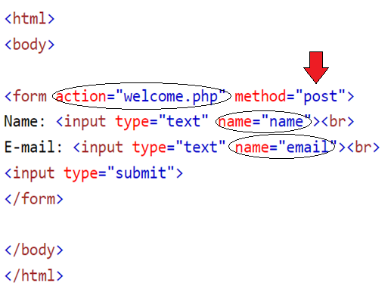
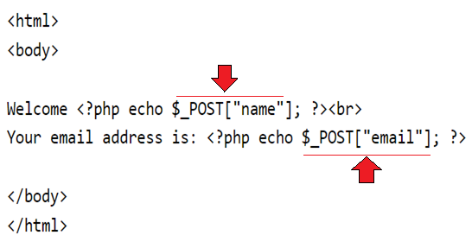
Patterns for processing HTML forms
The PHP super-globals $_GET and $_POST are used to collect form-data.
welcome.html
welcome.php
Notes:
https://www.w3schools.com/php/php_forms.asp

Slide 22
Patterns for processing HTML forms
The PHP super-globals $_GET and $_POST are used to collect form-data.
  $_GET is used to collect form data sent with Get method
  $_POST is used to collect form data via Post method
  $_SESSION is used to perform session tracking in php
  $_FILES is an associate double dimension array and keeps all the information related to uploaded file
  NB: - we should use PHP super-globals in capital letters only
  E.g : for a form control with a name attribute value of name we can write php code to retrieve value entered as follows:
$_POST[‘name’] or $_GET[‘name’]
When we have the following code in html
<input type=“text” name=“name” >
Notes:
https://www.w3schools.com/php/php_forms.asp

Slide 23

Form
<form action="file_uploader.php" method="post" enctype="multipart/form-data">
<input type="text" name="username" placeholder="username">
<input type="file" name="filename" /><br /><br />
<input type="submit" value="Upload File” name="upload"/>
</form>
HTML Code
if(isset($_POST["upload"]))
{
$user=$_POST["username"];
$filename=$_FILES["filename"]["name"];
$filesize=$_FILES["filename"]["size"];
$filetemp=$_FILES["filename"]["tmp_name"];
$filetype=$_FILES["filename"]["type"];
echo "your name is ".$user."<br>";
echo "file name is ".$filename."<br>";
echo "file size is ".$filesize."<br>";
echo "file temp is ".$filetemp."<br>";
echo "file type is ".$filetype."<br>";
}
PHP Code
file_uploader.php

Slide 24
Dynamically generating HTML
Php can dynamically generate html content
For example : - create a heading tag with php
  <?php echo”<h1> Hello world </h1>”; ?>
More example : - Create a table
  <?php echo”<table border=‘1’>”
  echo”<tr>”;
  echo”<td> Table data </td> “;
  echo”</tr>”;
  ….
  echo”</table>”;
  ?>
We can create any html code as we like with php

Slide 25
PHP MySQL database functions
PHP 5 and later can work with a MySQL database using:
  MySQLi extension (the "i" stands for improved)
  PDO (PHP Data Objects)
Earlier versions of PHP used the MySQL extension. However, this extension was deprecated in 2012.
        PHP MySQLi Functions:
          mysqli_connect()
          mysqli_query()
          mysqli_num_rows()
          mysqli_fetch_array()
          mysqli_error()
          mysqli_close()

Slide 26
Database connection
PHP mysqli_connect()
  The PHP mysqli_connect() function is used to connect to a MySQL database server.
  It has the following syntax.
  HERE,
    “$db_handle” is the database connection resource variable.
    “mysqli_connect(…)” is the function for php database connection
    “$server_name” is the name or IP address of the server hosting MySQL server.
    “$user_name” is a valid user name in MySQL server.
    “$password” is a valid password associated with a user name in MySQL server.

Slide 27
Selecting the database
PHP mysqli_select_db() function
  The mysqli_select_db() function is used to select a database.
  It has the following syntax.
  HERE,
    “mysqli_select_db(…)” is the database selection function that returns either true or false
    “$database_name” is the name of the database

Slide 28
Executing SQL Queries
PHP mysqli_query() function
  The mysqli_query function is used to execute SQL queries.
  The function can be used to execute the following query types;
    Insert
    Select
    Update
    delete
  It has the following syntax.
HERE,
“mysqli_query(…)” is the function that executes the SQL queries.
“$query” is the SQL query to be executed

Slide 29
Executing SQL Queries
PHP mysqli_num_rows() function
The mysqli_num_rows() function is used to get the number of rows returned from a select query.
It has the following syntax.
HERE,
“mysqli_num_rows(…)” is the row count function
“$result” is the mysqli_query result set

Slide 30
Executing SQL Queries
PHP mysqli_fetch_array() function
The mysqli_fetch_array() function is used to fetch row arrays from a query result set.
It has the following syntax.
HERE,
“mysqli_fetch_array(…)” is the function for fetching row arrays
“$result” is the result returned by the mysqli_query function.

Slide 31
Closing mysql connection
PHP mysqli_close() function
The mysqli_close function is used to close an open database connection.
It has the following syntax.
HERE,
“mysqli_close(…)” is the PHP function

Slide 32
Practical Examples
Assume that database is created with name: my_personal_contacts having a table named: my_contacts which contain attributes (ID, Full Names, Gender, Contact No, Email, City, Country)
Database Connection (dbconnection.php)
<?php
$dbh = mysqli_connect('localhost', 'root', '') or
die("Unable to connect to MySQL: " . mysqli_error($dbh));
if (!mysqli_select_db($dbh, ‘my_personal_contacts'))
die("Unable to select database: " . mysqli_error($dbh));
?>

Slide 33
practical examples
2. Inserting new records
<?php
include “dbconnection.php”;
$sql_stmt = "INSERT INTO `my_contacts`(`full_names`,`gender`,`contact_no`,`email`,`city`,`country`)";
$sql_stmt .= " VALUES('Peter','Male','541',' peter @ gmail.com ','AA','Ethiopia')";
$result = mysqli_query($dbh,$sql_stmt); //execute SQL statement
if (!$result)
die("Adding record failed: " . mysqli_error($dbh));
else
echo "Peter has been successfully added to your contacts list";
mysqli_close($dbh);
?>

Slide 34
practical ex…
<?php
include “dbconnection.php”;
$sql_stmt = "SELECT * FROM my_contacts";
$result = mysqli_query($dbh,$sql_stmt);
if (!$result)
die("Database access failed: " . mysqli_error($dbh));
$rows = mysqli_num_rows($result);
if ($rows) {
while ($row = mysqli_fetch_array($result)) {
echo 'ID: ' . $row['id'] . '<br>';
echo 'Full Names: ' . $row['full_names'] . '<br>';
echo 'Gender: ' . $row['gender'] . '<br>';
echo 'Contact No: ' . $row['contact_no'] . '<br>';
echo 'Email: ' . $row['email'] . '<br>';
echo 'City: ' . $row['city'] . '<br>';
echo 'Country: ' . $row['country'] . '<br><br>';
}
}
mysqli_close($dbh); //close the database connection
?>
3.Reading records from database

Slide 35
practical examples
<?php
include “dbconnection.php”;
$sql_stmt = "UPDATE `my_contacts` SET `contact_no` = '785’ where `email` = ' peter @gmail.com ';
$result = mysqli_query($dbh,$sql_stmt);
if (!$result)
die("Deleting record failed: " . mysqli_error(($dbh));
echo "ID number 5 has been successfully updated";
?>
4. Updating records
5. Deleting records
<?php
include “dbconnection.php”;
$sql_stmt = "DELETE FROM `my_contacts` WHERE `id` = $id";
$result = mysqli_query($dbh,$sql_stmt); //execute SQL statement
if (!$result)
die("Deleting record failed: " . mysqli_error(($dbh));
echo "ID number $id has been successfully deleted";
?>

Slide 36
Session-tracking
Sessions allow you to easily
  create multipage forms (such as shopping carts),
  save user authentication information from page to page, and
  store persistent user preferences on a site
Creating, accessing, or deleting a session begins with the session_start() function.
This function will attempt to send a cookie the first time a session is started, so it absolutely must be called prior to any HTML or white space being sent to the Web browser.
Therefore, on pages that use sessions, you should call the session_start() function as one of the very first lines in your script

Slide 37
Session-tracking
Once the session has been started, you can record data to it by assigning values to the $_SESSION array:
$_SESSION[‘first_time’]=“bikila”;
$_SESSION[‘hits’]=1;
Each time a value is assigned to the $_SESSION array, PHP writes that data to a temporary file stored on the server
To access the session data use $_SESSION with its index.
  echo $_SESSION[‘first_time’];
remove the session data from the server using
session_destroy()

Slide 38
The End!

